Slide 1
Chap 4. Linked Lists (2)

Slide 2
Contents
4.1 Singly Linked Lists and Chains
4.2 Representing Chains in C
4.3 Linked Stacks and Queues
4.4 Polynomials
4.5 Additional List Operations
4.8 Doubly Linked Lists

Slide 3
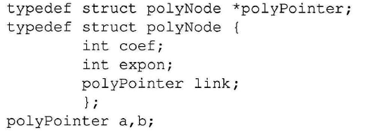

4.4 Polynomials
4.4.1 Polynomial Representation
Polynomial
a_{i} : nonzero coefficients
e_{i} : nonnegative integer exponents
Representation of Polynomial
polyNode;
Notes:
a_{i} : nonzero coefficients
e_{i} : nonnegative integer exponents
Assuming that the coefficients are integers, …

Slide 4

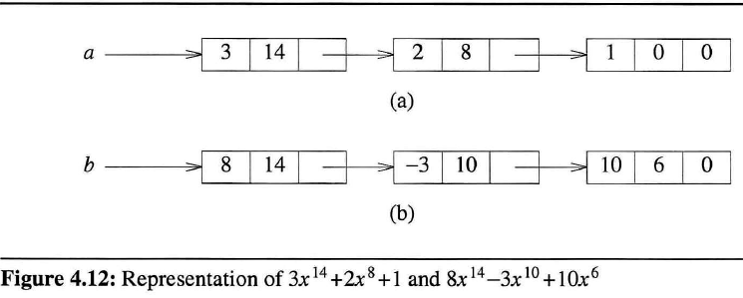
Representation of polynomials

Slide 5
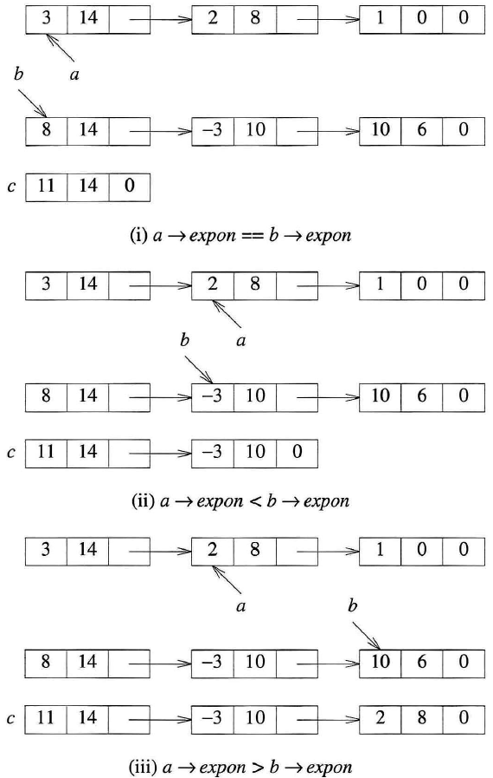
4.4.2 Adding Polynomials

Slide 6
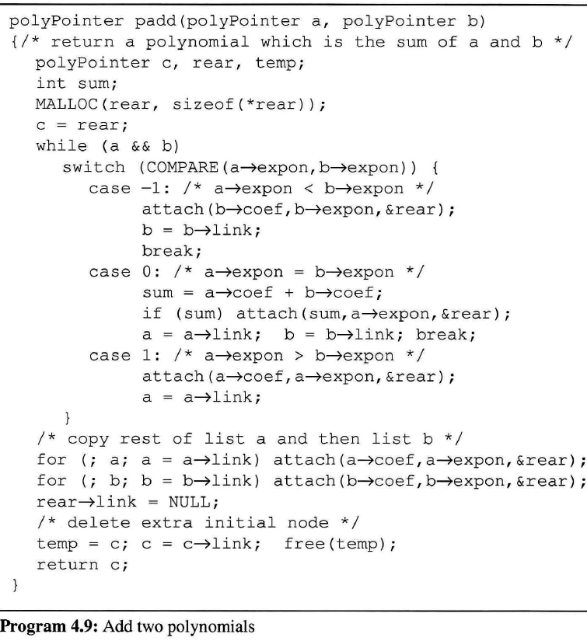
Notes:
Initially, we give c a single node with no values, which we delete at the end of the function.
Although this is somewhat inelegant, it avoids more computation.
※ COMPARE : p.12 macro

Slide 7
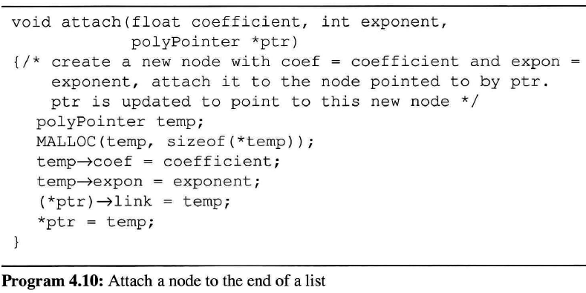
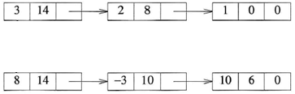
a
temp
a single node with no values
c
b
rear
attach( 11, 14, &rear )
attach(float coefficient, int exponent, PolyPointer *ptr)
ptr
11
14
temp

Slide 8
a
temp
c
b
rear
11
14
attach( -3, 10, &rear )
ptr
-3
10
attach(float coefficient, int exponent, PolyPointer *ptr)
temp

Slide 9
a
temp
c
b
11
14
rear
-3
10
attatch( 2, 8, &rear )
ptr
attatch(float coefficient, int exponent, PolyPointer *ptr)
2
8
temp

Slide 10
a
temp
c
b
11
14
-3
10
rear
2
8
attach( 10, 6, &rear )
attach(float coefficient, int exponent, PolyPointer *ptr)
ptr
10
6
temp

Slide 11
a
temp
c
NULL
b
11
14
-3
10
2
8
rear
10
6
attach( 1, 0, &rear )
attach(float coefficient, int exponent, PolyPointer *ptr)
ptr
1
0
temp

Slide 12
NULL
a
temp
c
NULL
b
11
14
-3
10
2
8
10
6
rear
1
0
0

Slide 13
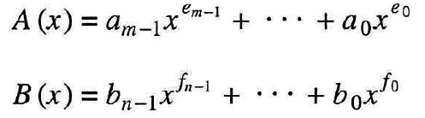
Analysis of padd
Three cost measures for this algorithm
(1) Coefficient additions
0 ≤ number of coefficient additions ≤ min{m, n}
Notes:
Assume that each of these operations( (1), (2), (3) ) takes a single unit of time if done once,
------------
m, n : the number of terms of a, b
Lower bound, 0, is achieved when none of the exponents are equal,
while the upper, {m, n}, is achieved when the exponents of one polynomial are a subset of the exponents of the other.

Slide 14
(2) Exponent comparisons
One comparison on each iteration of the while loop
The number of iterations is bounded by m + n
ex) m+n-1 iterations for m = n and
(3) Creations of new nodes for c
The maximum number of terms in c is m + n
From (1)~(3),
the total time complexity is O (m + n)
Notes:
O(m+n) means…
the time it takes will be c₁m+c₂n+c₃, where c1, c2, c3 are constants.

Slide 15
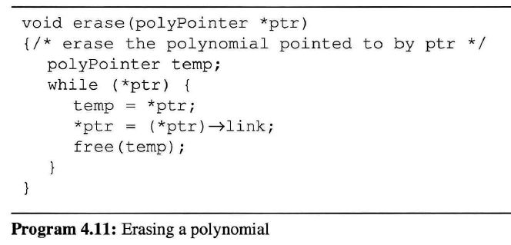
4.4.3 Erasing Polynomials
0
a
erase( &a )
temp
ptr
erase(polyPointer *ptr)
Notes:
For e(x) = a(x)*b(x) + d(x)
-----------------------
polyPointer a, b, d, e;
…
a = readPoly();
b = readPoly();
d = readPoly();
temp = pmult(a, b);
e = padd(temp, d);
printPoly(e);
----------------------
Since we created temp(x) only to hold a partial result for d(x), …
By returning the nodes of temp(x), we may use them to hold other polynomials.

Slide 16


4.4.4 Circular List Representation of Polynomials
Chain
A singly linked list in which the last node has a null link
Circular list
The link filed of the last node points to the first node in the list
first
0
first
Notes:
< Circular list >
Useful, for example, when each node represents a supplier and you want each supplier to be called on in round-robin order. Other applications seen later.
A variant of this has a header node—circular list with header node. When you don’t have a header node, it is often useful to have a last node pointer rather than a first node pointer. By doing this, additions to the front and end become O(1).

Slide 17
Available space list
A chain of nodes that have been “freed”
Use getNode and retNode, instead of malloc & free
When maintaining it,
we can obtain an efficient erase algorithm for circular list.
avail
0
Notes:
Available space list : a chain consisting of nodes that have been “freed”
Let avail be a pointer to the first node in the list of freed nodes. Initially set to NULL

Slide 18
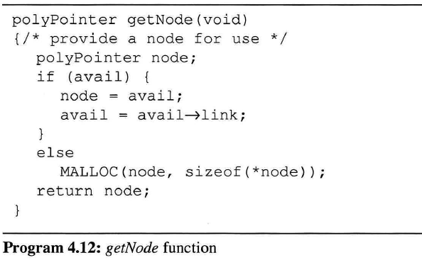
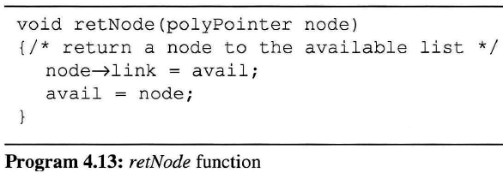
node
0
avail
node =
getNode()
node
getNode(void)
0
node
avail
retNode( node)
node
retNode(polyPointer node)
Notes:
getNode : get a node from avail list
retNode : return a node to avail list
Instead of using malloc and free, we now use getNode and retNode.

Slide 19
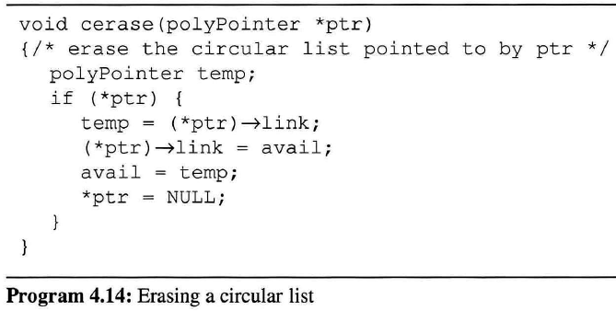
0
avail
NULL
first
cerase(&first)
ptr
temp
cerase(polyPointer * ptr)
Notes:
We may erase a circular list in a fixed amount of time (constant time) independent of the number of nodes in the list using cerase.
※ It’s ok for the circular list with the last node pointer.

Slide 20
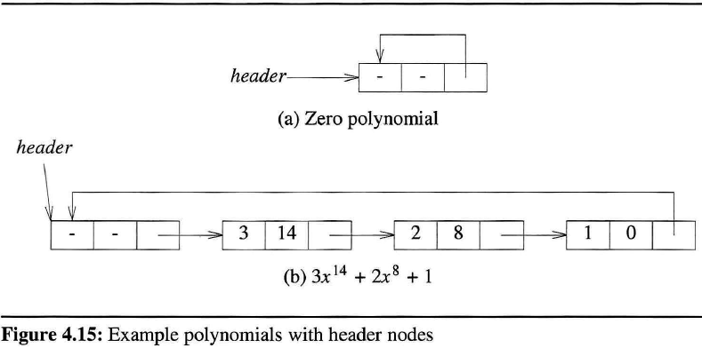
To avoid handling the zero polynomial as a special case, a header node is added.
Notes:
The expon and coef fields of the header node are irrelevant.

Slide 21
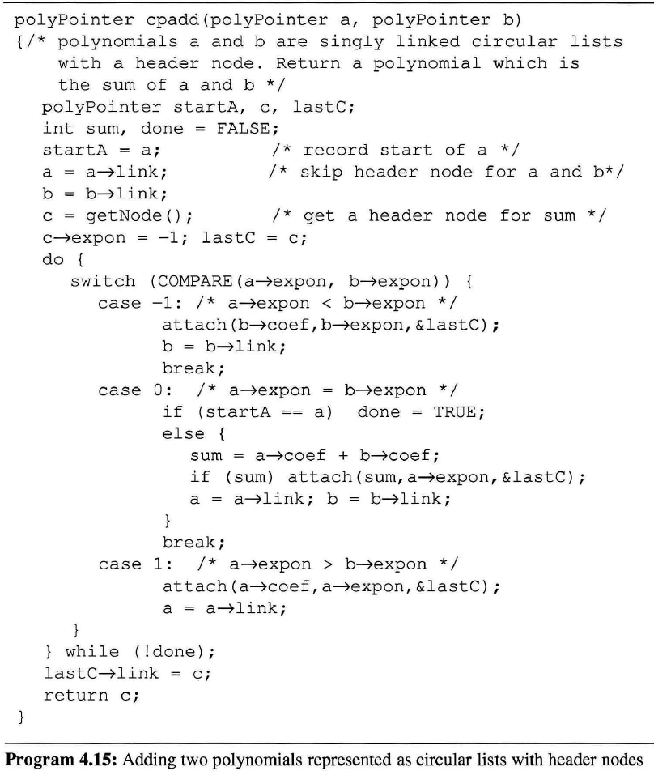
Notes:
To simplify the addition algorithm for polynomials represented as circular lists,
we set the expon field of the header node to -1.
cpadd() : avail 사용
attatch() : Program 4.10을 수정하기 → getNode() 사용하여 노드 할당

Slide 22
-1
startA
a
-1
c
b
lastC
-1

Slide 23
-1
startA
a
-1
c
b
lastC
-1
attach( 11, 14, &lastC )
attach(float coefficient, int exponent, PolyPointer *ptr)
ptr
11
14
temp

Slide 24
-1
startA
a
-1
c
b
-1
lastC
11
14
attach( -3, 10, &lastC )
-3
10
attach(float coefficient, int exponent, PolyPointer *ptr)
ptr
temp

Slide 25
-1
startA
a
-1
c
b
-1
11
14
lastC
-3
10
attach( 2, 8, &lastC )
attach(float coefficient, int exponent, PolyPointer *ptr)
ptr
2
8
temp

Slide 26
-1
startA
a
-1
c
b
-1
11
14
-3
10
lastC
2
8
attach( 10, 6, &lastC )
ptr
attach(float coefficient, int exponent, PolyPointer *ptr)
10
6
temp

Slide 27
-1
startA
a
-1
c
b
-1
11
14
-3
10
2
8
lastC
10
6
attach( 1, 0, &lastC )
1
0
attach(float coefficient, int exponent, PolyPointer *ptr)
ptr
temp

Slide 28
-1
startA
a
-1
c
b
-1
11
14
-3
10
2
8
10
6
lastC
1
0

Slide 29
-1
startA
a
-1
c
b
-1
11
14
-3
10
2
8
10
6
lastC
1
0

Slide 30
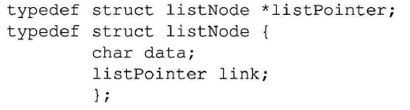
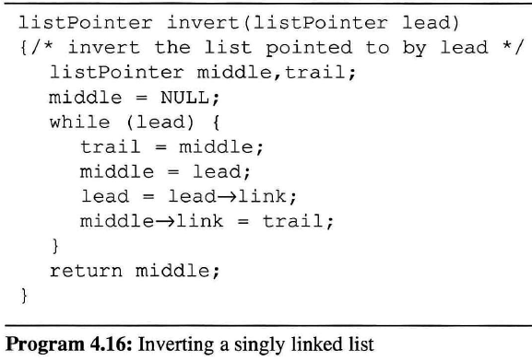
4.5 Additional List Operations
4.5.1 Operations For Chains
first
0
first = invert( first )
invert( listPointer lead )
NULL
lead
middle
trail
while
listNode;
first
0
0
lead
middle
NULL
trail
first
0
0
①
②
lead
③
middle
trail
④
first
0
NULL
lead
middle
trail
Notes:
Inverting a singly linked list : We can do it “in place” if we use three pointers.
For a list of length >=1 nodes, the while loop is executed length times ➔ O(length)

Slide 31
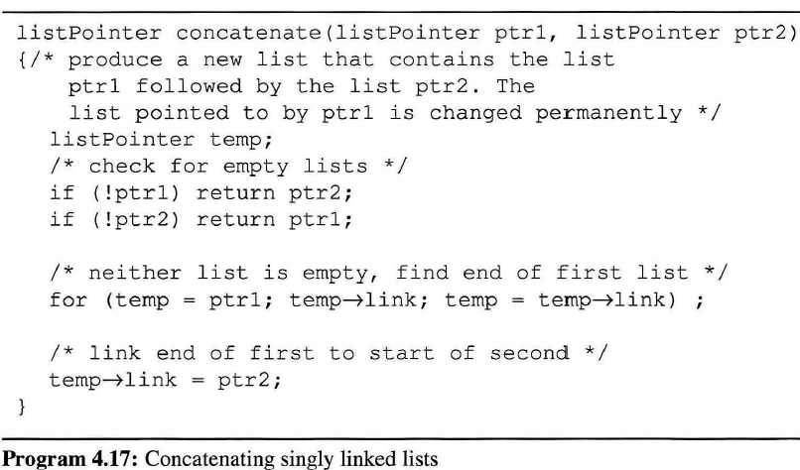
return ptr1;
second
first
0
0
concatList = concatenate( first, second )
concatenate( listPointer ptr1, listPointer ptr2)
ptr1
temp
ptr2
Notes:
Errata : add return ptr1; to the program
O(length of list ptr1)
The list pointed to by ptr1 is changed permanently.

Slide 32
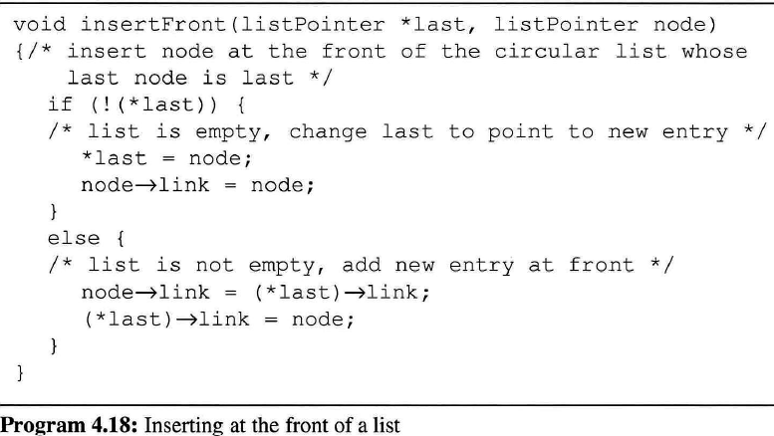
4.5.2 Operations For Circularly Linked Lists
last
node
insertFront(&last, node)
node
last
insertFront(listPointer *last, listPointer node )
Notes:
By keeping pointer last to the last node in the list rather than to the first, we are able to insert an element at both the front and end with ease.
(※ last 대신 first 포인터를 유지할 경우, front에 삽입할 때 리스트의 전체 길이 만큼 따라가서 마지막 노드가 삽입한 첫 노드를 가리키도록 수정해야 함)
Q. How to modify it into insertLast(…)?
add *last = node to the else clause

Slide 33
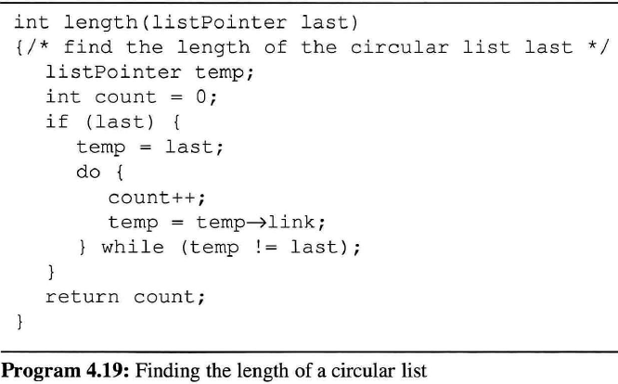
last
length( last )
count
0
temp
last
length( listPointer last )
1

Slide 34
4.8 Doubly Linked Lists
Limitation in chains and singly linked circular lists
The only way to find a specific node p or the node that precedes the node p is to start at the beginning of the list.
Easy deletion of an arbitrary node requires knowing the preceding node.

Slide 35
It is useful to have doubly linked lists, for a problem that
need to move in either directions
must delete an arbitrary node

Slide 36
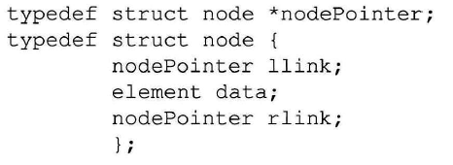
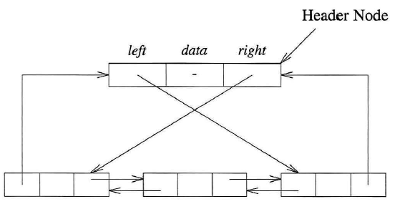
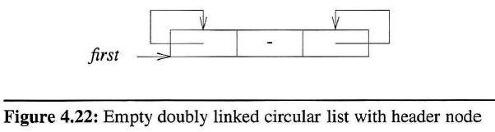
node;
header
llink data rlink
to the last node
to the first node
header
Notes:
1. Each node has two link files
linking in forward direction : rlink
linking in backward direction : llink
2. A doubly linked list may or may not be circular.
3. A header node allow us to implement our operations more easily.
The data filed of the header node usually contains no information.

Slide 37
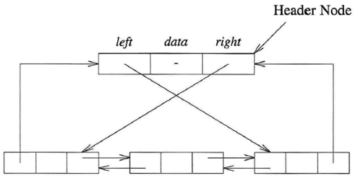
header
llink data rlink
ptr
If ptr points to any node in a doubly linked list, then
This formula reflects that
we can go back and forth with equal ease.

Slide 38
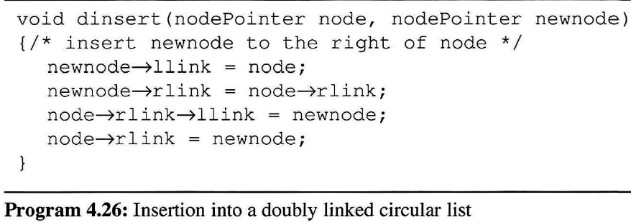
①
②
③
④
header
-
④
②
③
①
node
newnode
Notes:
Figure : p.188, Exercise 1

Slide 39
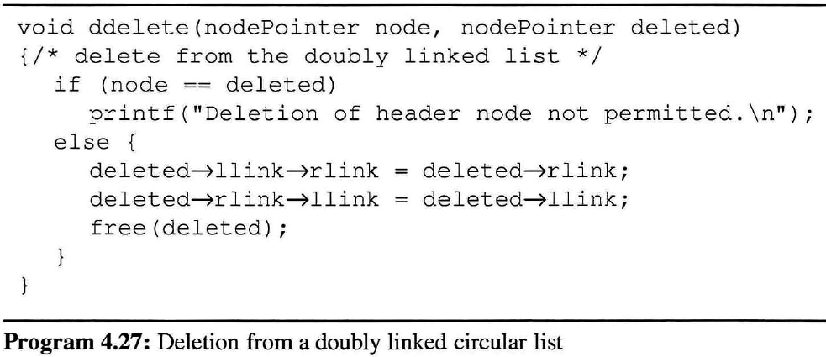
①
②
③
header
-
①
②
node
deleted
Notes:
Figure : p.188, Exercise 2

Slide 40
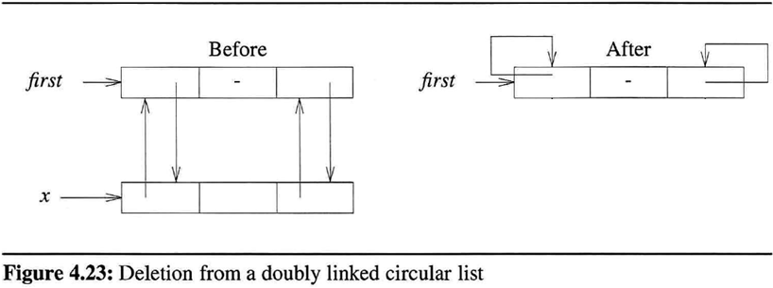
header
header
with a single node
Notes:
Figure 4.23 : 그림 수정

